Slide 1

VOTING SYSTEM
B.Tech – Review Section Name :A-12
Project Team Members :-
Guided by
K.INDUMATHI MAM
S.No | Name | Admission no | Register no
1 | M.MARUTHI NAVADEEP | 20225902 | 99220041253

Slide 2
INTRODUCTION
Generally, the voting system consists of ballot boxes and uses paper voting.But,it is usually not efficient and a very time consuming process. Many times in this voting system, there are many invalid votes present due to the paper folding or making two of options mistakenly…..etc.,
This voting system project aims to develop an application that facilitates the voting process by allowing registered voters to cast their votes for a list of candidates.
The project focuses on creating a user-friendly interface that verifies voter identity, prevents multiple voting, records and counts votes, and determines the winner based on the highest vote count.
By implementing this project, it becomes easier to manage and organize elections, enabling a democratic and efficient voting system. This project also plans to read the data from the dataset.

Slide 3
OBJECTIVES OF THE PROJECT
The objectives of this project are to simplify the voting system by using software.
The objectives of the voting system project can include:
Implementing a user-friendly interface: The project aims to provide a user-friendly interface for voters to input their voter ID, password, and vote. This involves using input prompts and displaying clear instructions and information about the candidates and their platforms.
The project verifies the voter's identity by matching the entered voter ID and password against a predefined list of voters and passwords. This ensures that only registered voters can cast their votes.
The project includes functionality to prevent a voter from casting multiple votes. It checks if the voter has already voted by keeping track of the voter IDs of those who have already cast their votes.

Slide 4
OBJECTIVES OF THE PROJECT
The project records each voter's valid vote and maintains a vote count for each candidate using a dictionary. This allows for accurate counting and tracking of votes.
The project determines the winner based on the highest vote count . In the case of a tie, it handles the tie appropriately.
Displaying the vote count and winner: The project displays the vote count for each candidate and announces the winner by displaying their name, vote count, and indicating if there is a tie. This provides transparency and allows voters to see the outcome of the voting process.
Overall, the objectives of the project are to create a functional and reliable voting system that ensures the integrity of the voting process, accurately counts the votes, and determines the winner based on the recorded votes.

Slide 5
OPERATIONS/FEATURES
1. Voter’s ID Verification
2.Multiple Voting Identification
3.Ease of new user Registration
4.Recording and counting votes
5.Determining the winner
6.Changing the passwords
These are the various Operations and feautures in this project.

Slide 6
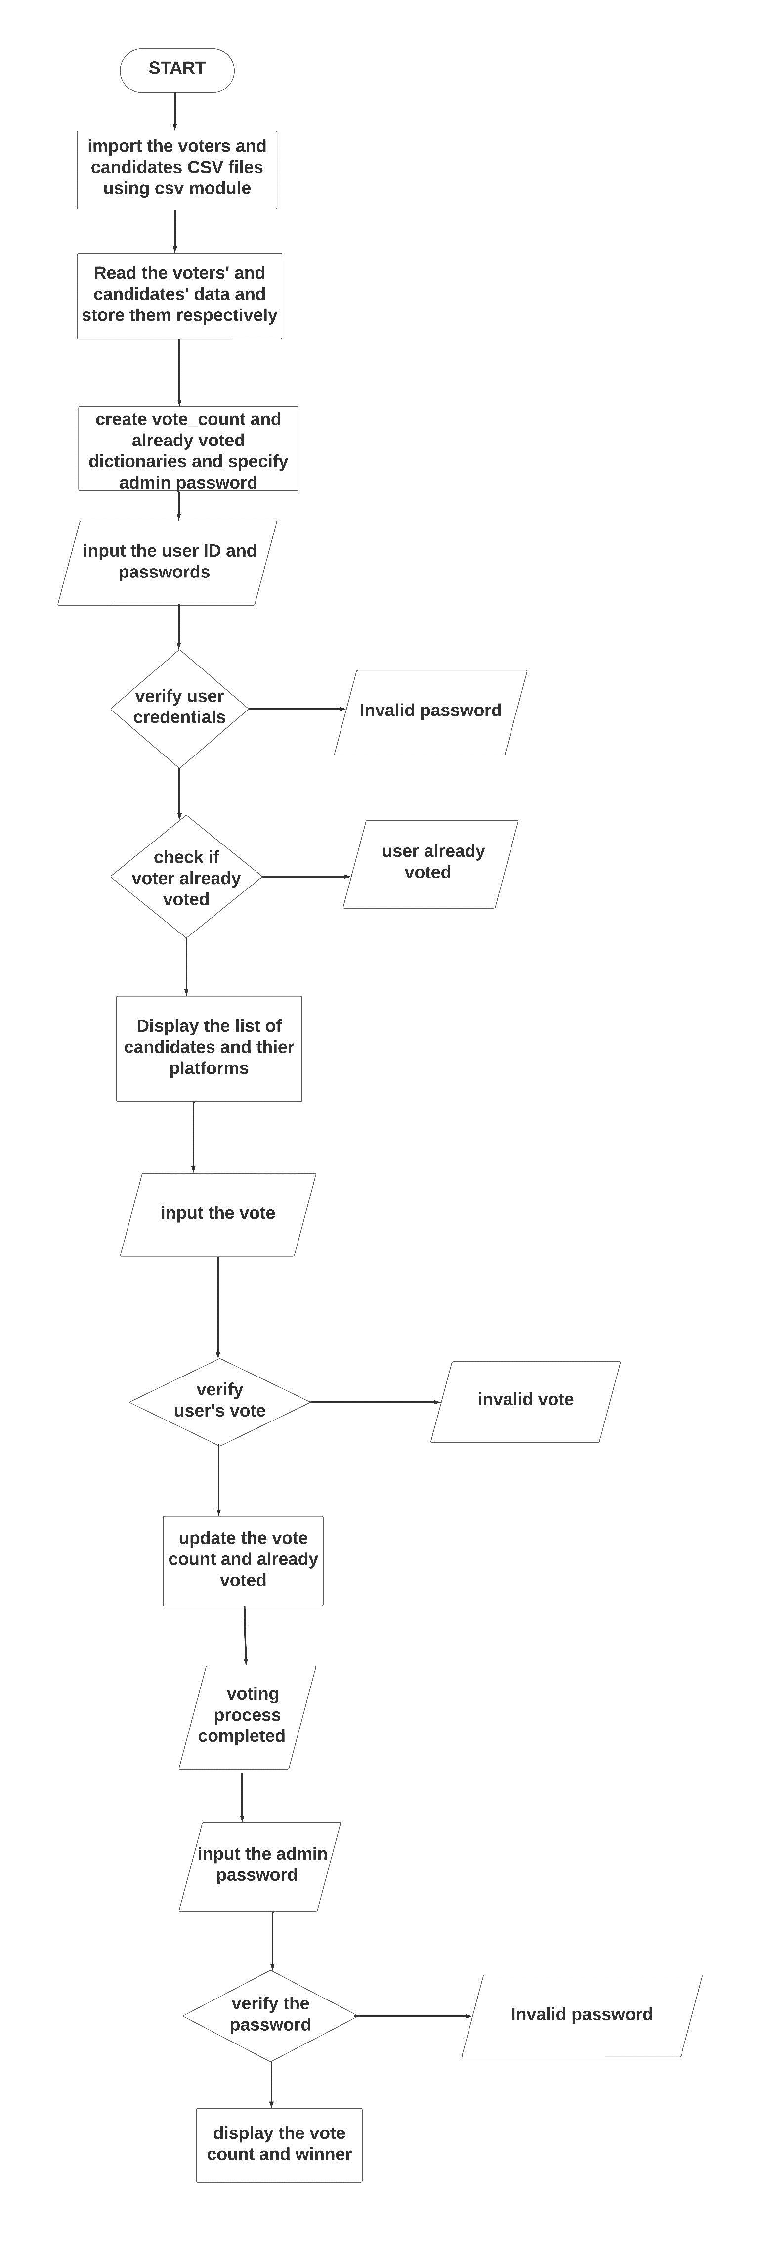
FLOW CHART

Slide 7
Advantages/Benefits
1.Efficiency and Accuracy: The system automates the voting process, eliminating manual counting and reducing the chances of human error. It ensures accurate vote counting and quick results, providing a more efficient and reliable voting experience.
2.Transparency and Integrity: The system maintains a record of each vote cast, ensuring transparency and accountability in the voting process. It prevents tampering or manipulation of votes, increasing the integrity of the election.
3Prevention of Multiple Voting: The system includes checks to prevent multiple voting by the same individual. It verifies the voter's identity and ensures that they can only cast a single vote, enhancing the fairness and legitimacy of the election.
4Ease of Use: The system provides a user-friendly interface for voters to input their voter ID, password, and vote. It simplifies the voting process, making it accessible to a wide range of users, including those with limited technical expertise.

Slide 8
5Time and Cost Savings: By automating the voting process, the system reduces the time and resources required for manual vote counting and result declaration.
Overall, using an automated voting system offers increased efficiency, transparency, accuracy, and security compared to traditional manual voting methods. It enhances the democratic process by providing a reliable and accessible platform for voters to express their choices.

Slide 9
OPERATORS/FUNCTIONS
A comprehensive list of the functions, modules, and operations used in the simple voting system project:
input(): Receives input from the user.
print(): Displays output to the user.
if-else statements: Performs different actions based on conditions.
for loop: Iterates over a sequence of items.
range(): Generates a sequence of numbers.
Lists: Stes the candidates' names and platforms, as well as the list of voters and their passwords.
Dictionaries: Stores the vote count for each candidate.
str(): Converts variables to strings for concatenation and formatting.
operator: Concatenates strings.
max() function: Finds the maximum value from a sequence.

Slide 10
key parameter in max(): Specifies the criteria for finding the maximum value.
break statement: Exits a loop prematurely.
len() function: Returns the length of a list.
== operator: Compares if two values are equal.
+= operator: Updates the value of a variable by adding a new value.
.get() method for dictionaries: Retrieves the value associated with a given key.
.items() method for dictionaries: Retrieves key-value pairs from a dictionary.
!= operator: Compares if two values are not equal.
str() function: Converts integers to strings for concatenation.
\n: Represents a newline character for formatting output.
These are all the functions, modules, and operations used in the simple voting system project.

Slide 11
CONCEPTS APPLIED
Data structures /types
Conditional statements
looping
character formatting
Functions

Slide 12
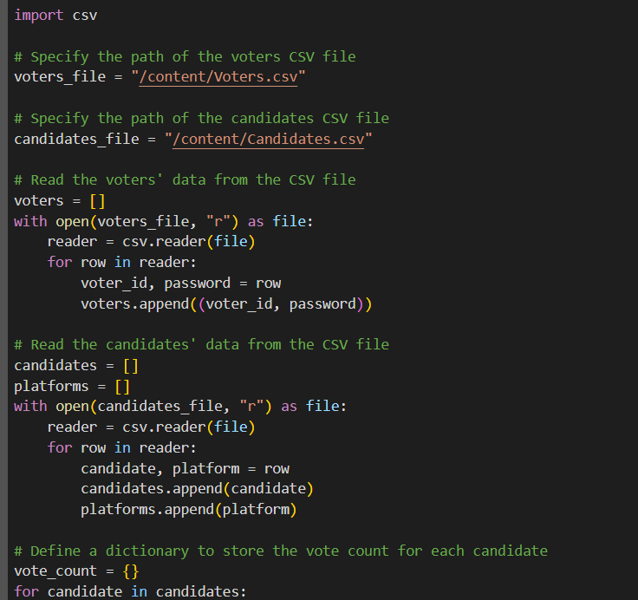
IMPLEMENTATION:

Slide 13
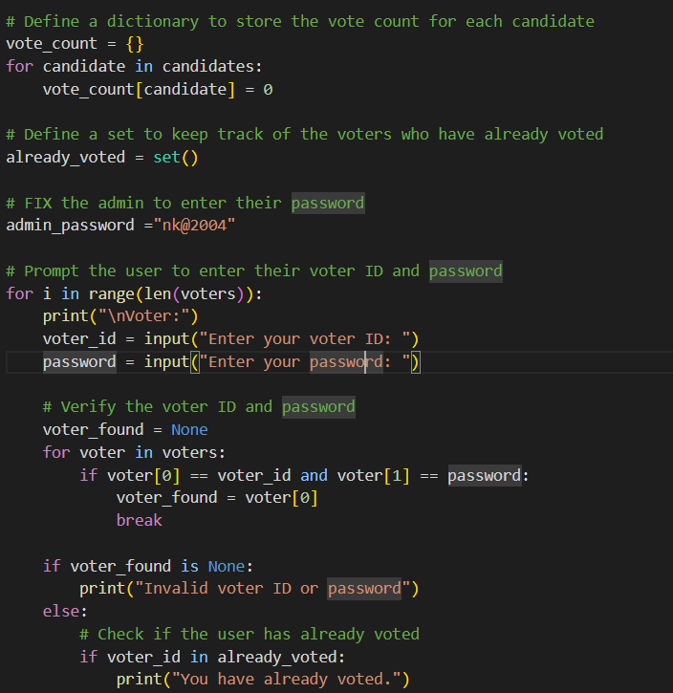

Slide 14
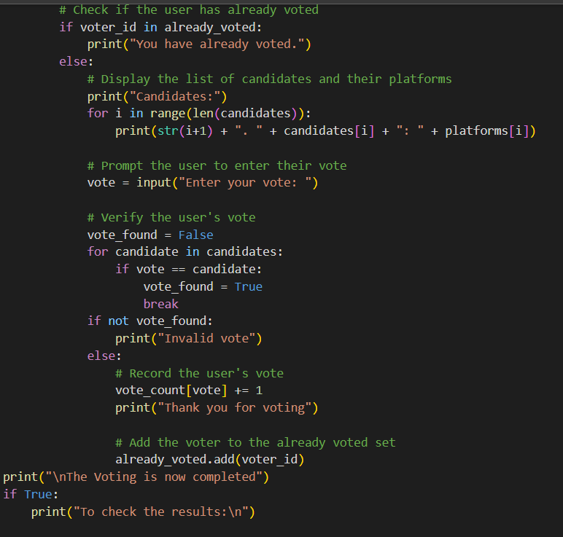

Slide 15
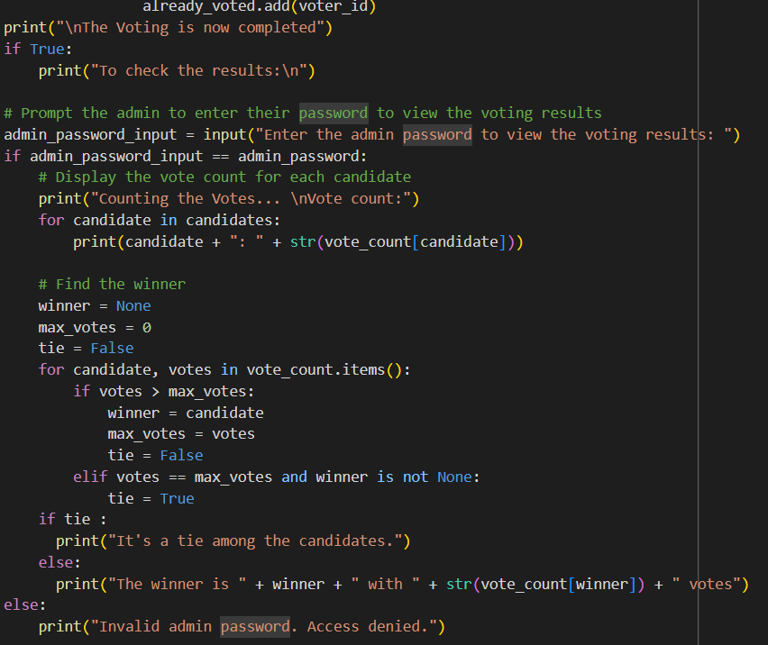

Slide 16
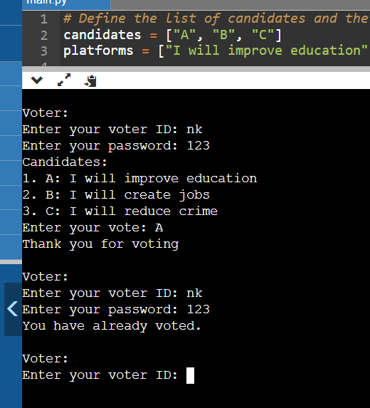
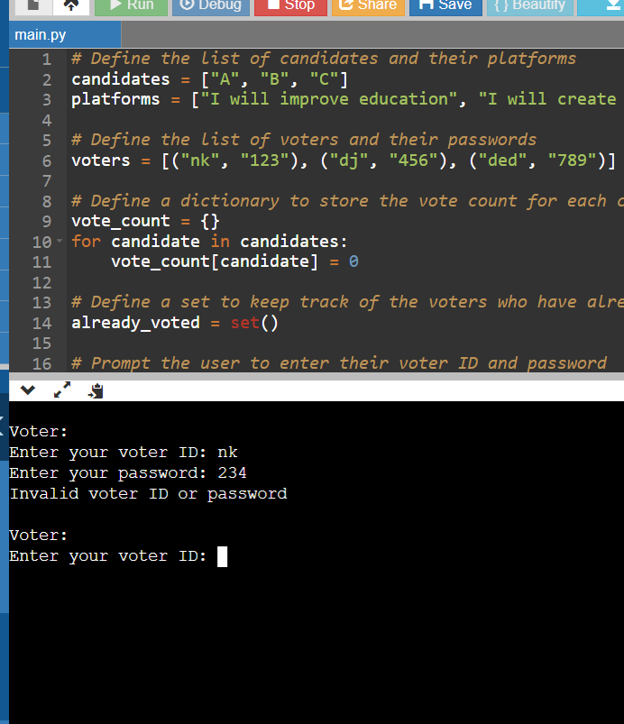
SCREENSHOT IMPLEMENTATION

Slide 17
